Slide 1

Workshop Cogent
S-Team
Coaches: Dieter De Witte, Dilawar Ali
Notes:
Draguet: het eindresultaat moet zichtbaar zijn

Slide 2
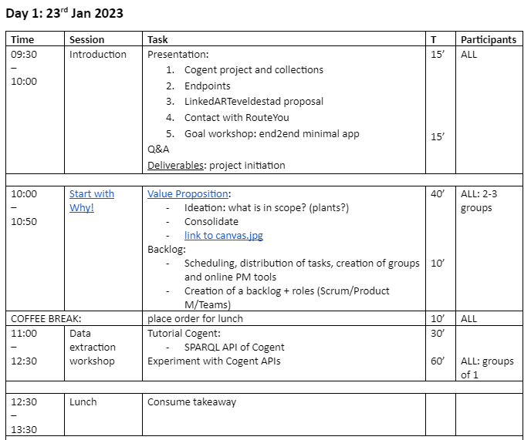
Monday morning overview

Slide 3
Part I
Cogent project and collections
LinkedARTeveldestad proposal
Contact with RouteYou
Goal workshop: end2end minimal app

Slide 4
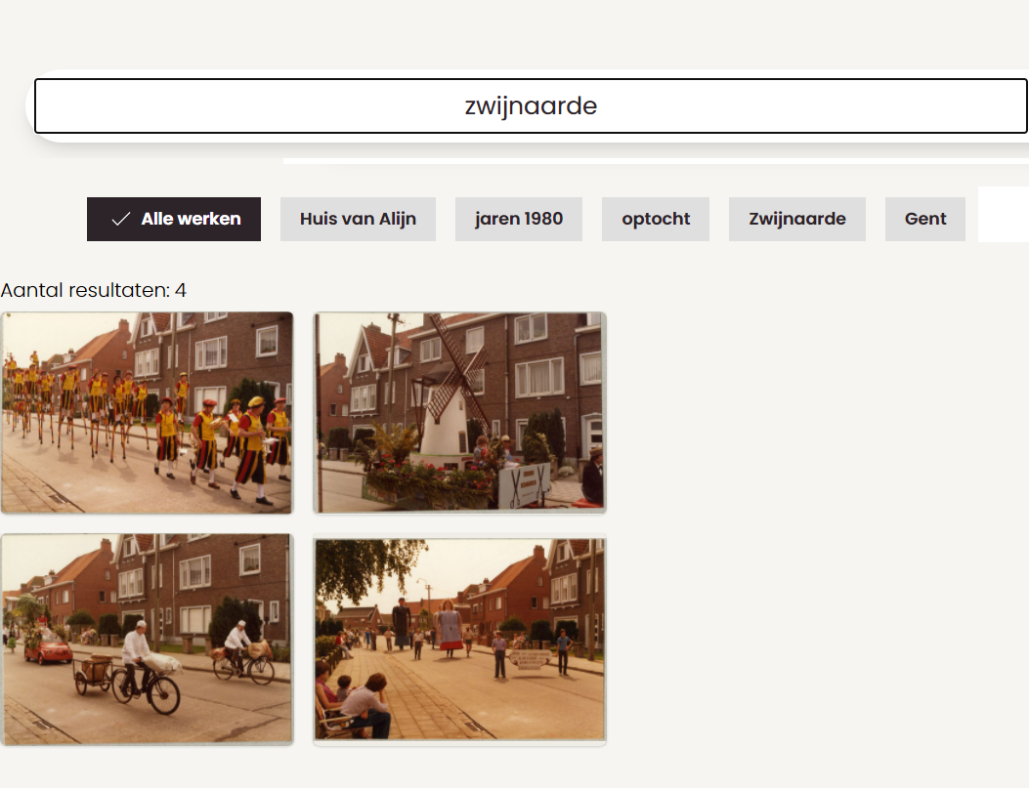
data.collectie.gent (front-end)

Slide 5
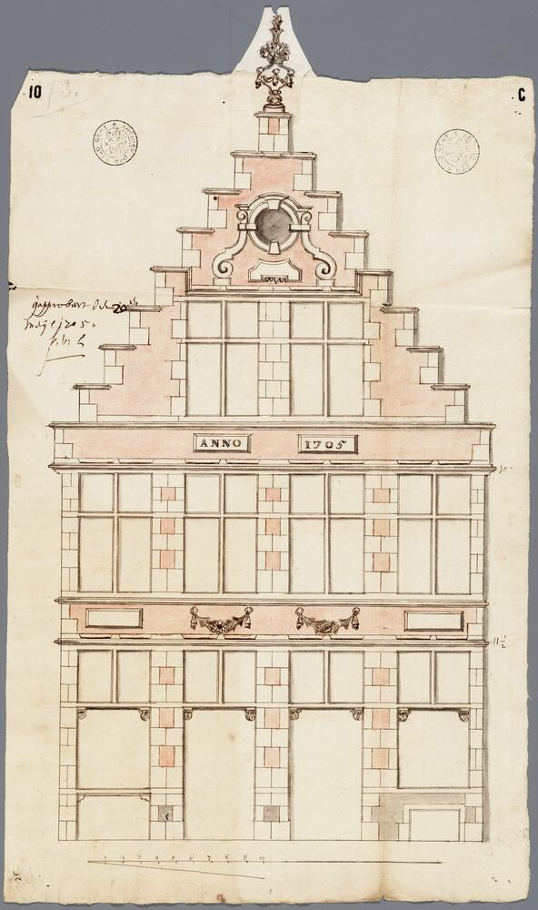
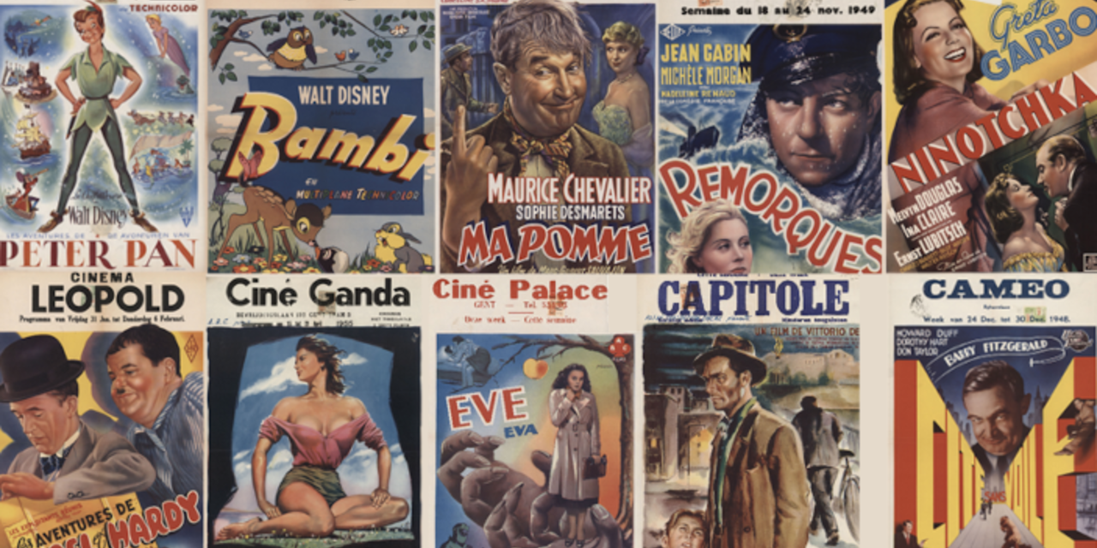
1. Archief Gent: plans, pictures; cards
6,500 records (plans)
7,562 records (pictures, cards of Ghent city views)

Slide 6
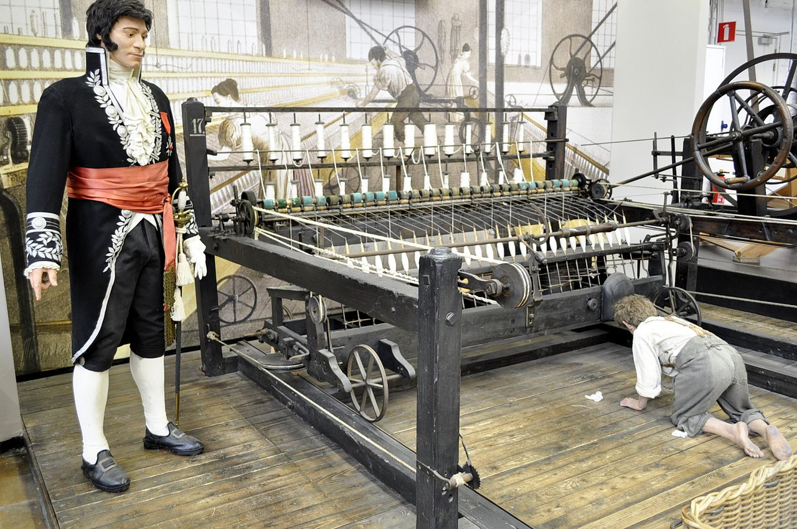
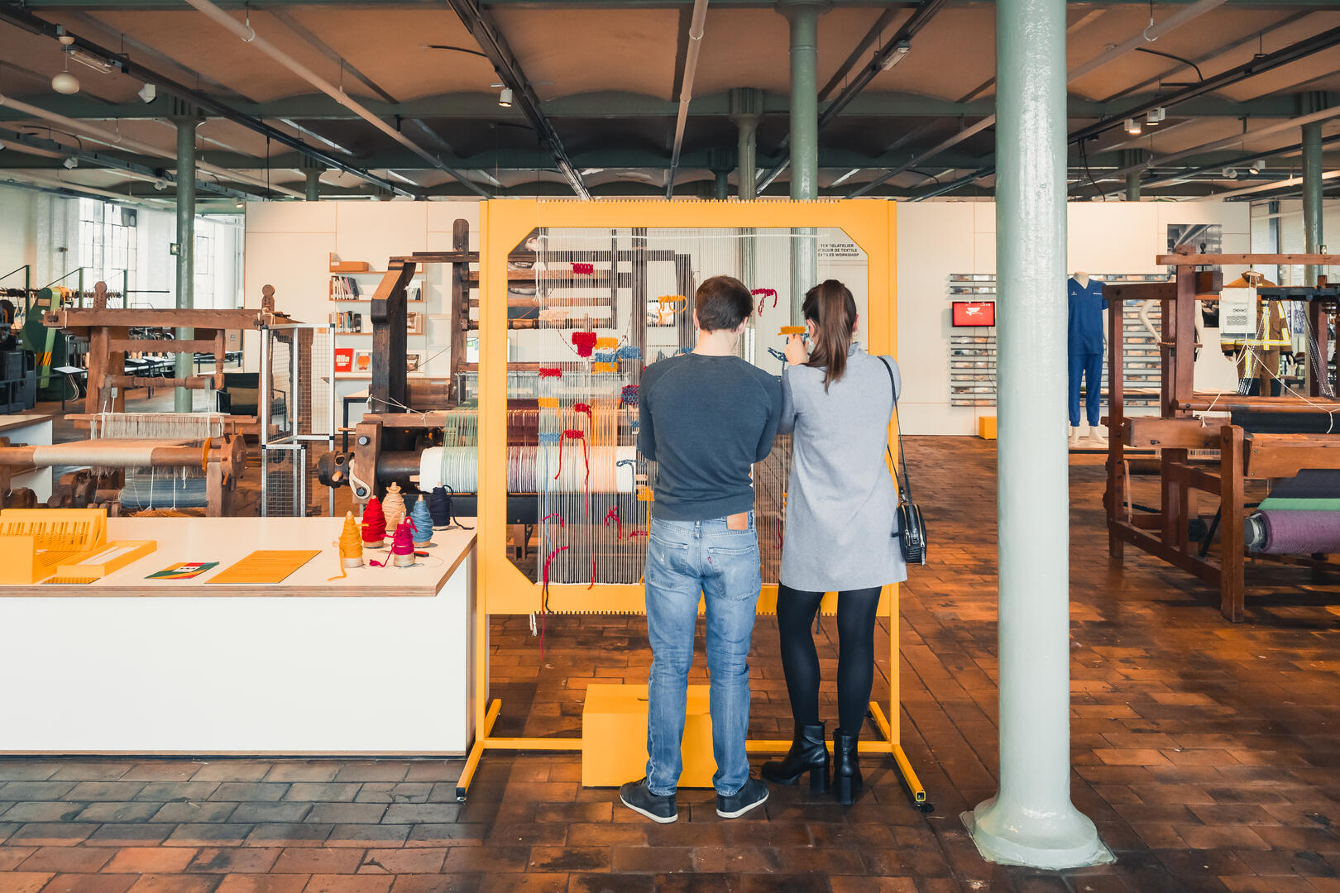
2. Industriemuseum
7,822 records (website)
9,833 records (heritage)
Notes:
doesn’t look very accessible

Slide 7
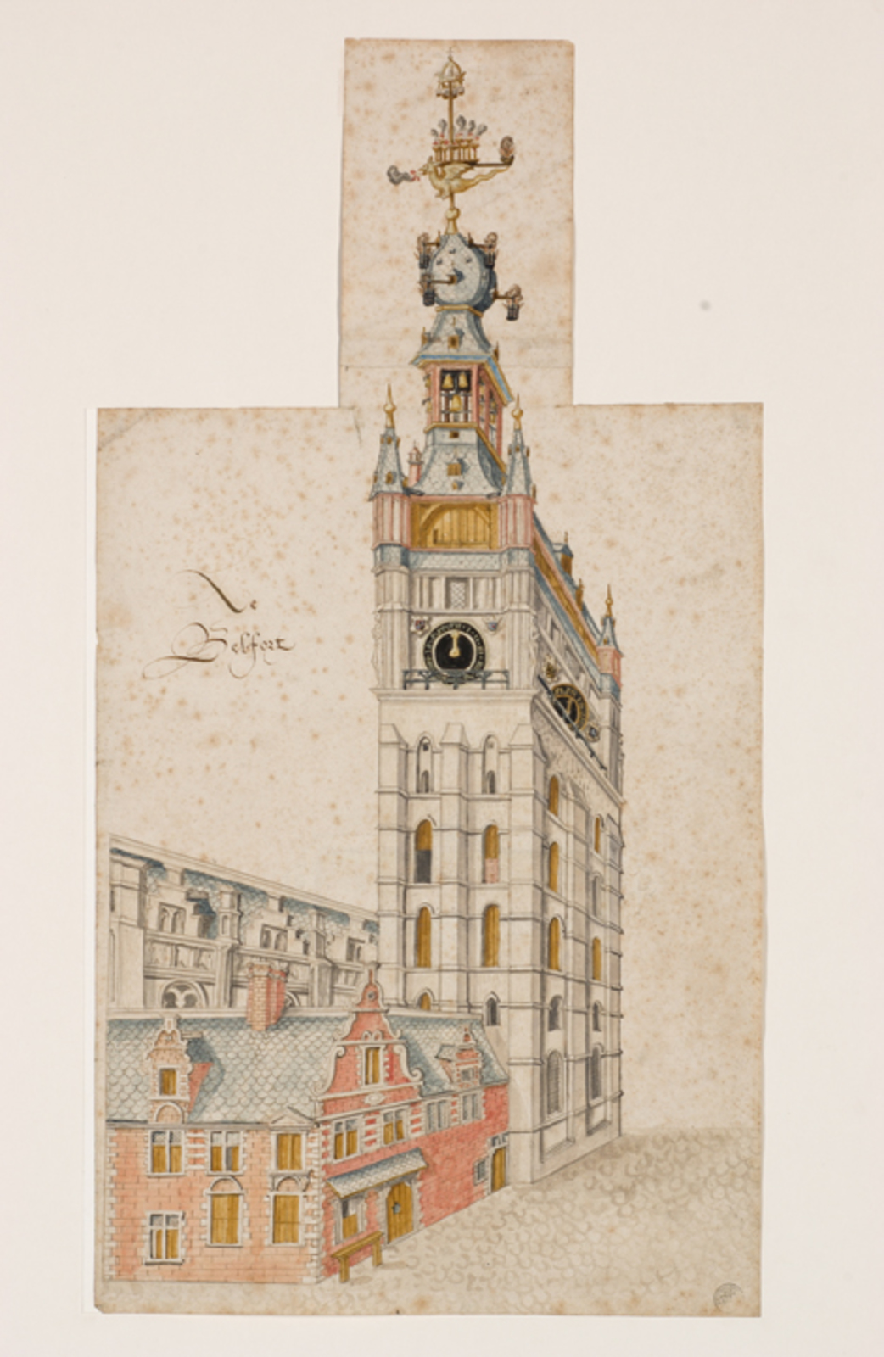
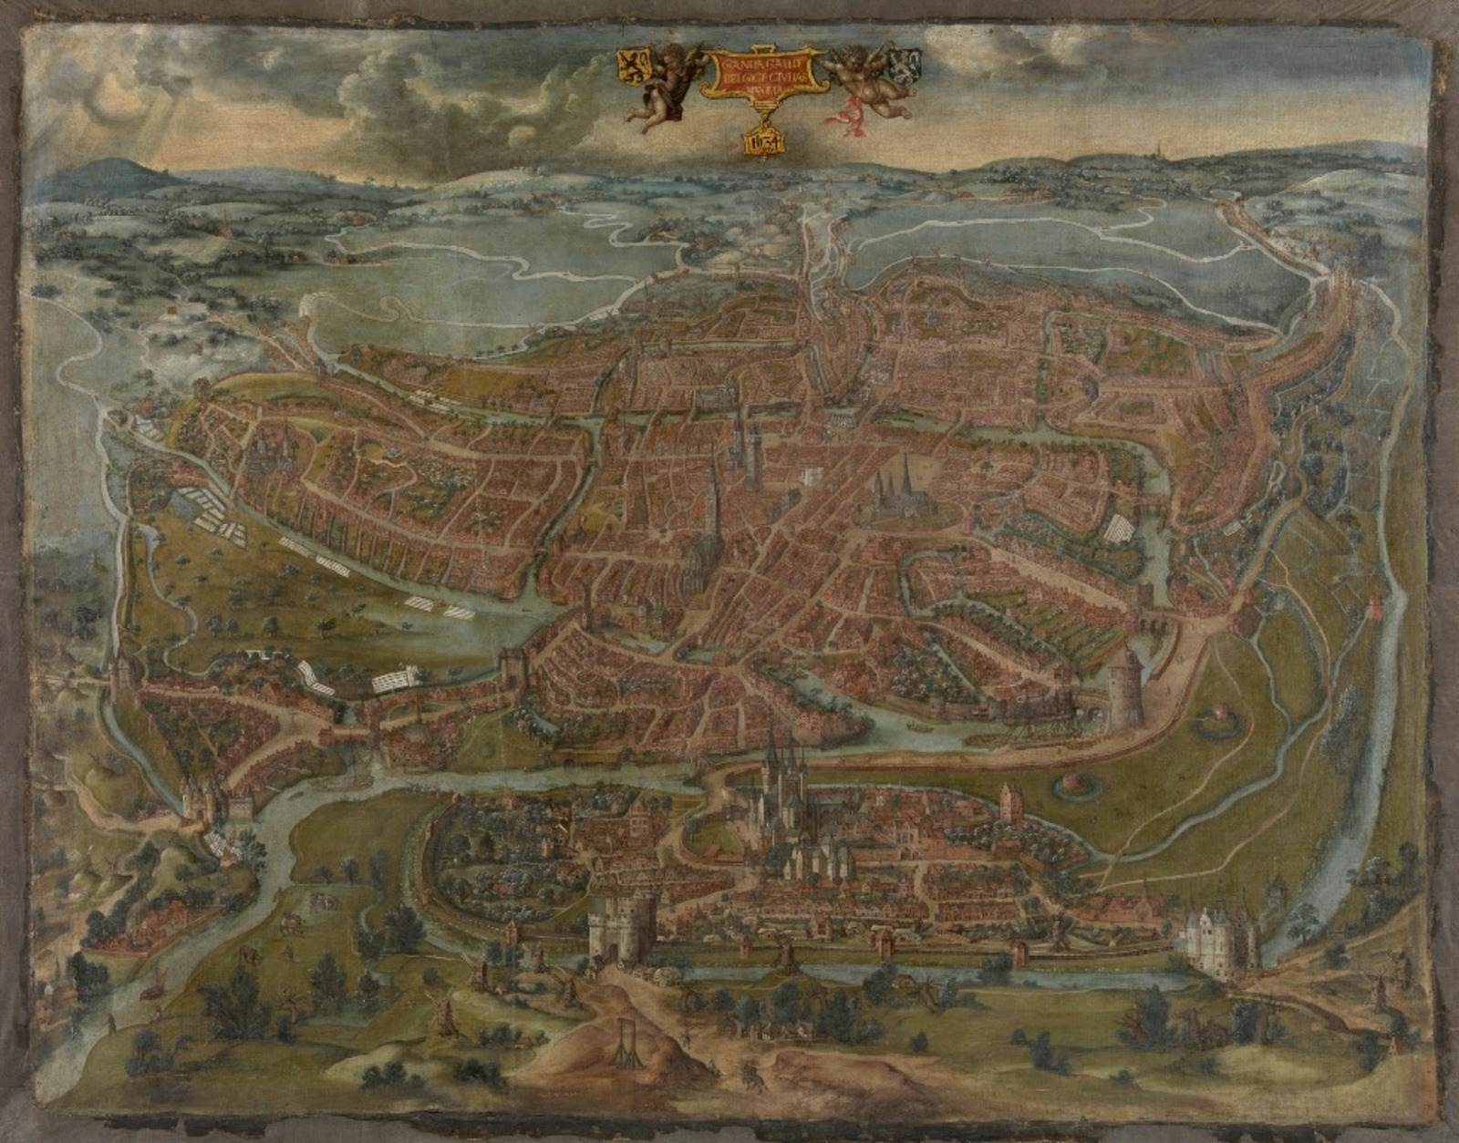
3. STAM (city views, China, crafts, tokens)
13,000 records

Slide 8
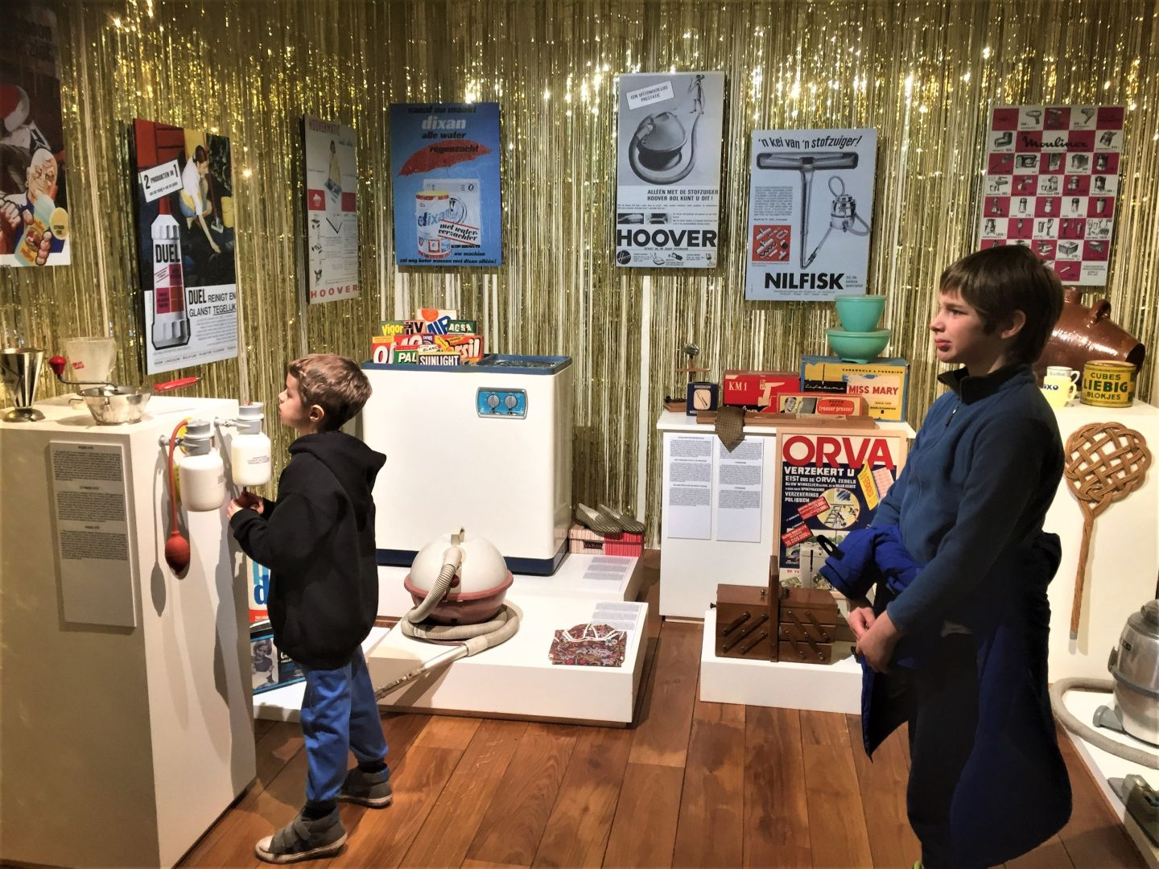
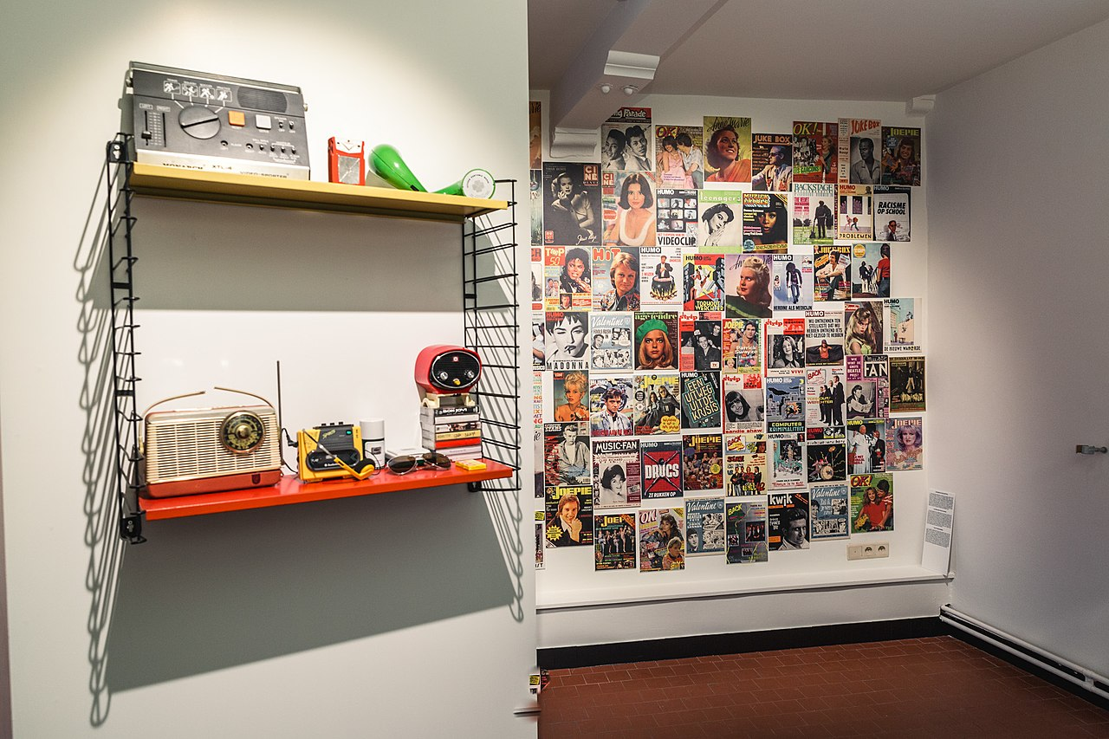
4. Huis van Alijn (calendars, cards)
8,073 records (topics: toys, birth, Christmas,...)

Slide 9


5. Design Museum (furniture, kitchen tools,...)
Physical art objects

Slide 10
Linked ARTeveldestad
Themes based on:
CV
Semantics (wiki game)
Basic NLP
Can we create thematic routes through Gent containing art items of Coghent*?
*5 musea == 5 locations (short, thematic blitz visits of 30' per museum)
Example: Flower query:
{ "query": "bloemen", end: "gastronomic", 'max_length": 4} POI (RouteYou)

Slide 11

Technical Solution: hurdles
Requirement ~ support for 4 months ( 2 april - 2+3 juni Open Cultuurfestival Collectie van de Gentenaar
=> hardware
=> personnel
<> budget of 20k
Runamic
does not compile
Krishna left

Slide 12
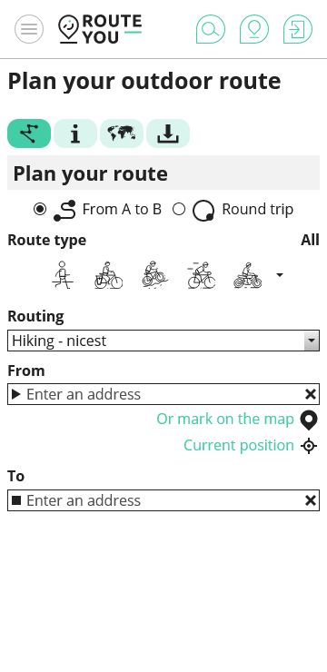
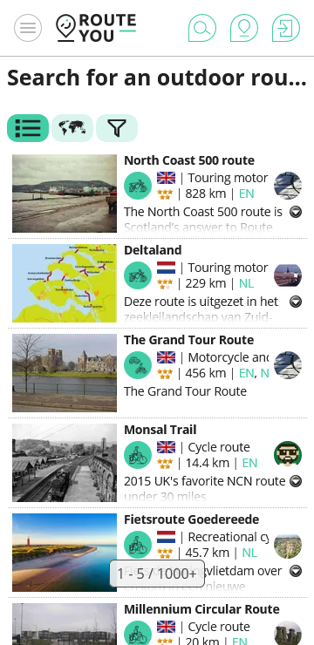
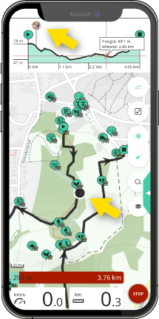
Practical solution
Buy PRO account (1k)
Private environment with own routes ~ cogent.routeyou.com
SLA: not our problem
Free app with large userbase
Large KG with thematic POIs
Custom Routing algorithms

Slide 13
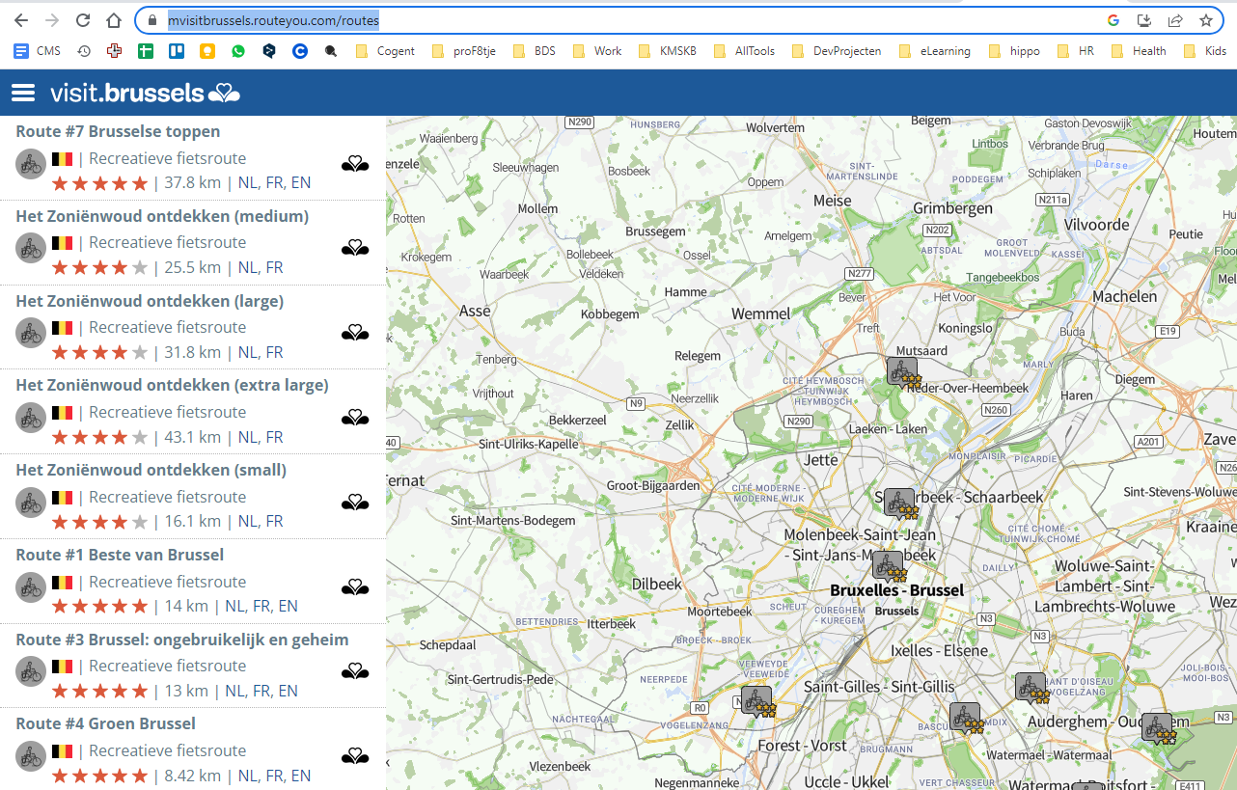
https://mvisitbrussels.routeyou.com/routes
Notes:
m

Slide 14
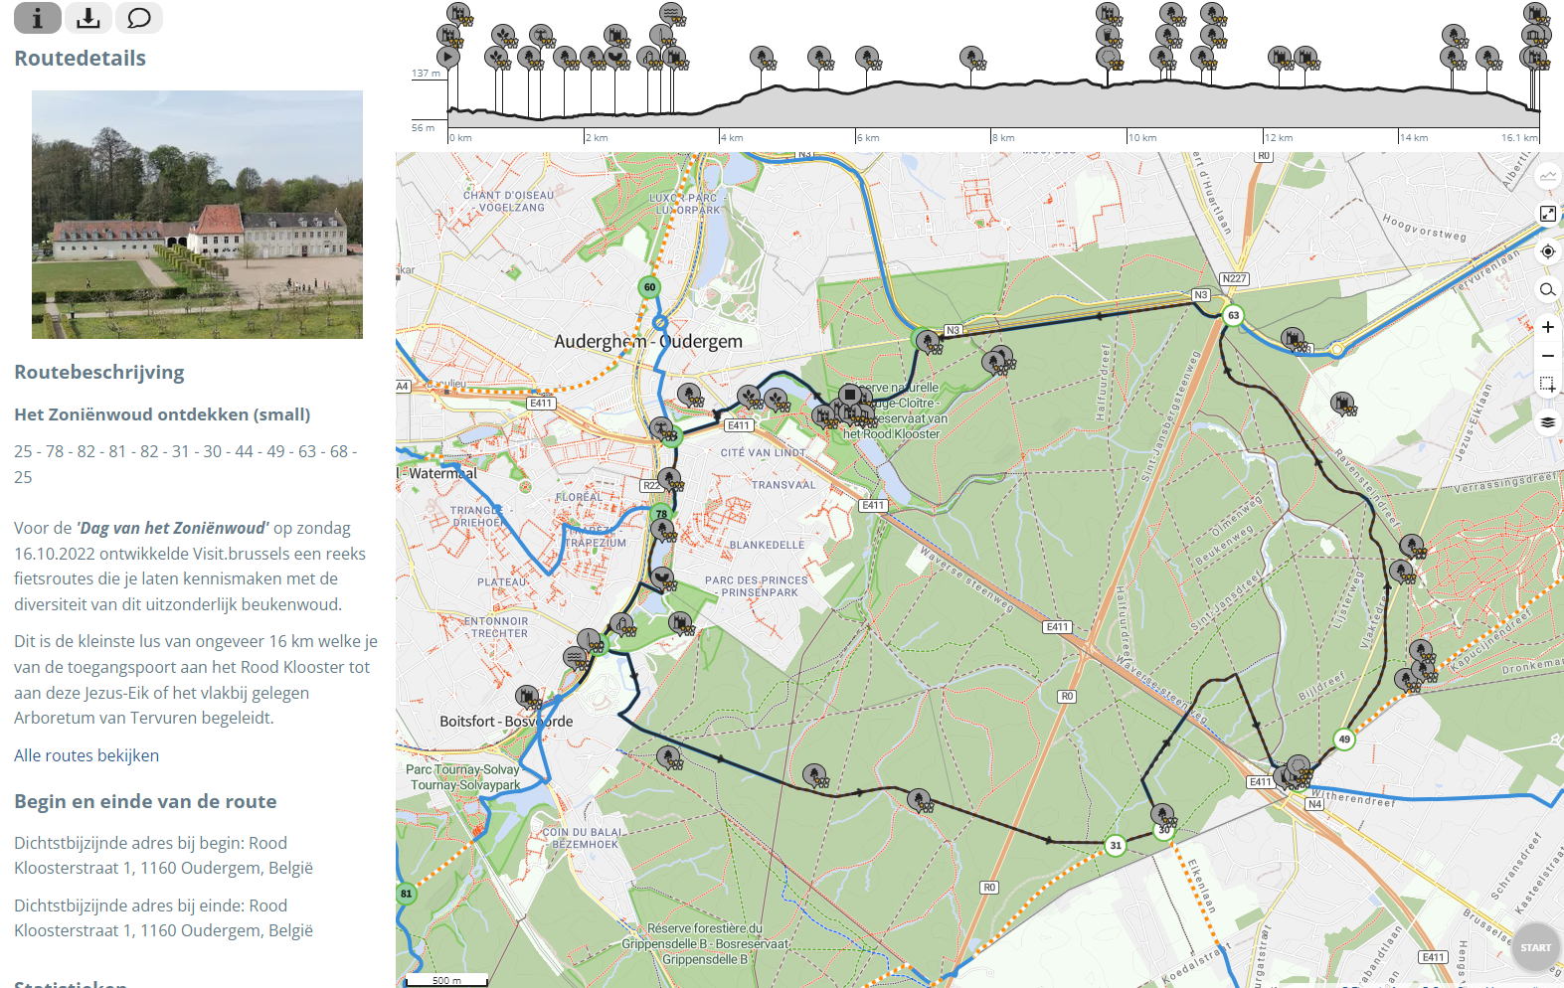

Slide 15
Goal of our PoC
Generate / Enrich collections of POIs
CV relations
Semantic relations
NLP
Additional POIs extracted from RouteYou
Ingest POIs in RouteYou
generate large number of routes
museum converators select their favorites
Iterative
Improvement

Slide 16
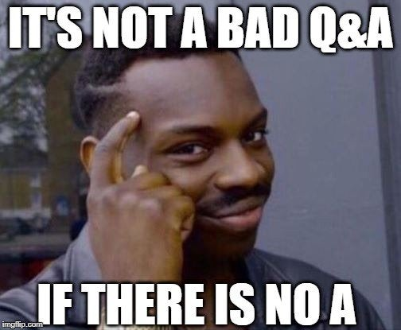
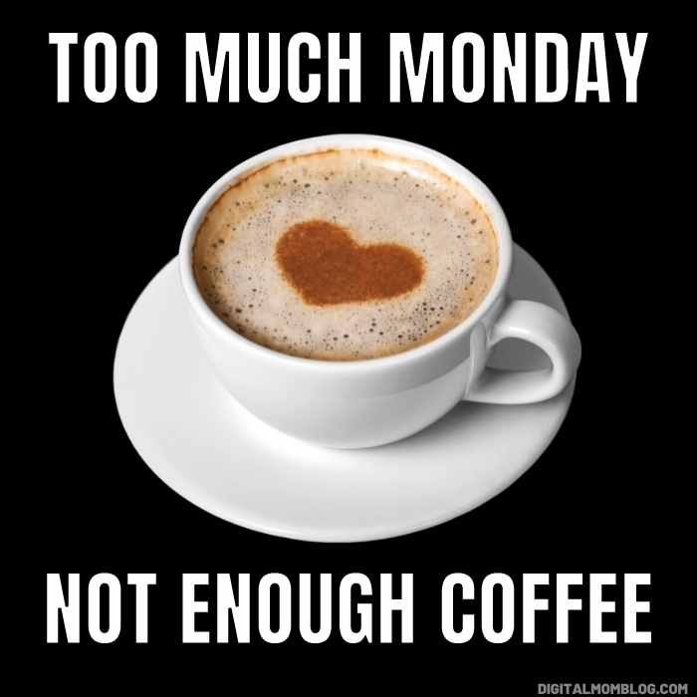
+

Slide 17
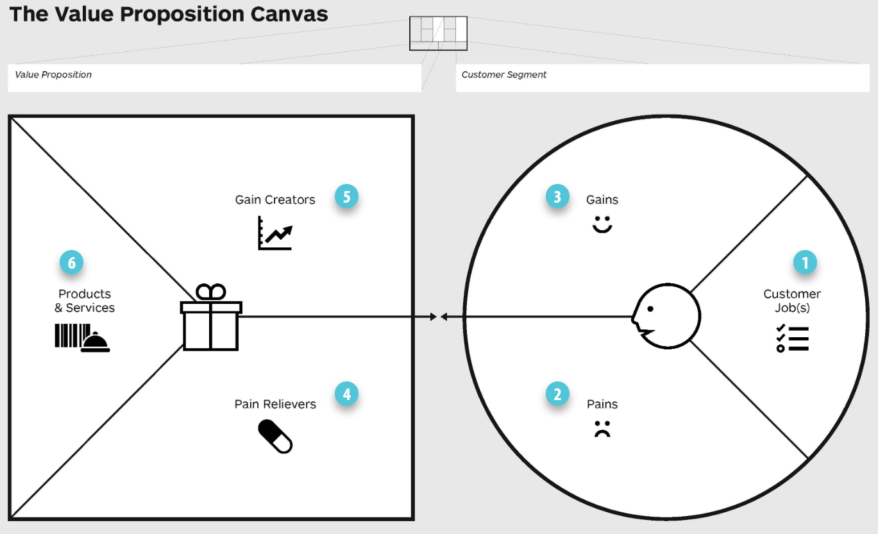
Part II: Ideation
https://www.designabetterbusiness.tools/tools/value-proposition-canvas
ALWAYS START WITH THE CUSTOMER

Slide 18
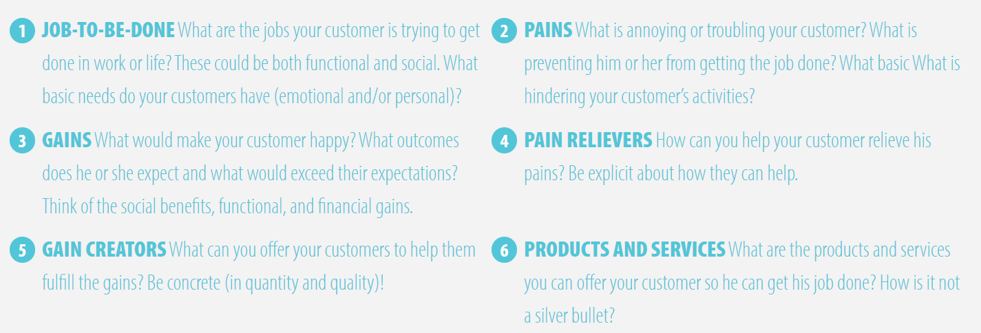
Info about canvas (https://www.designabetterbusiness.tools/tools/value-proposition-canvas)
Tool to really understand the customer
Who's our customer!?
Gather around canvas in groups of 2-5
Attach post-its // write on a board
GAIN <> PAIN: gains are helping the ambitions of the customer, pains are what is necessary to survive

Slide 19
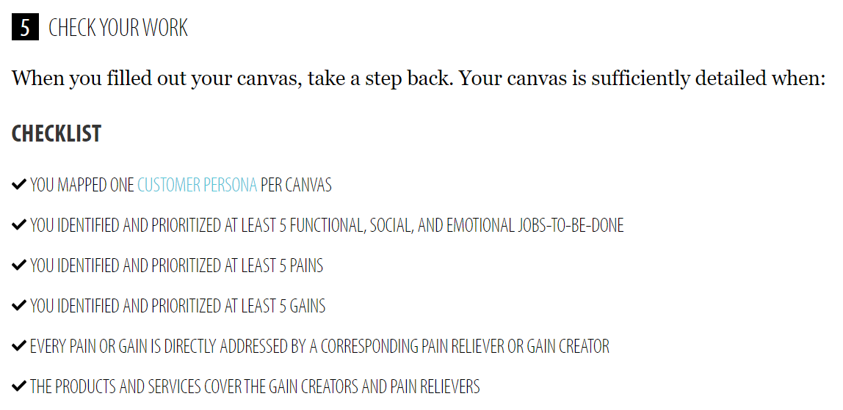
Feel free to leave the room, come back when...
TODO afterwards:
proposal also analyzed
customer needs

Slide 20
Create a backlog in Github
Create issues
Create stories
Assign yourself to a number of stories
SCRUM discussion: roles + assign priorities

Slide 21
Example Backlog
connection with RouteYou
connection with Cogent APIs
POI extraction en bijhorende tekst van RouteYou
Similarities based on existing tags
Similarities on tags + language model?
Definieer KPI, QA: wanneer is de PoC klaar?
Image enrichment
UI: RouteYou company page
Conduct unit/integration tests
Iterations to improve stepwise on similiariites
Route generation + proceed from here?
NOT iets doen met Krishnas tools voor plantenherkenning?

Slide 22
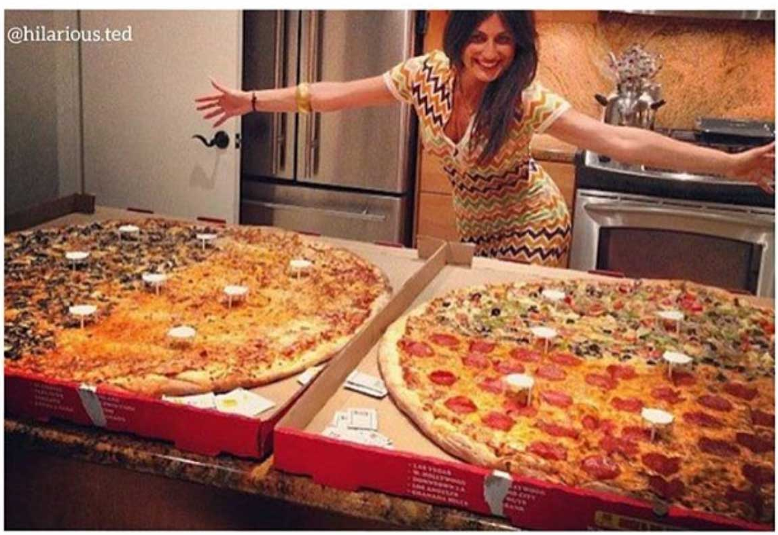
10:50 Grab a coffee Order lunch

Slide 23

Part III: Quest for data

Slide 24
Tutorial Cogent: access to data
What are KGs? What's SPARQL?
Endpoints Cogent
webclient for query validation
starters notebook
example queries
Python SPARQL client

Slide 25
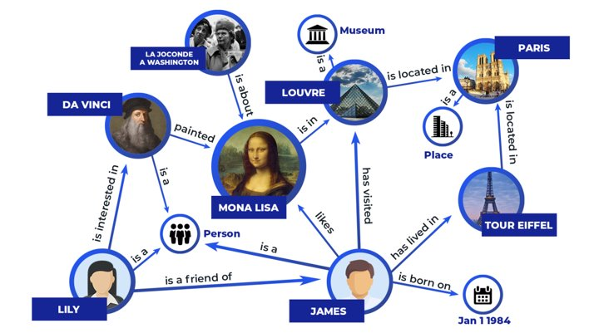
Knowledge Graphs 101
Notes:
* Slide toont een KG. +
* Concepten = nodes worden gelinkt via predicates = edges
* Class: James is van de klasse person (is a Person)=> hij heeft een geboortedatum/plaats
* KG: we voeren een aantal extra constraints / formatting vereisten toe / standaarden => KG kan gemakkelijker geintegreerd worden met een andere KG

Slide 26
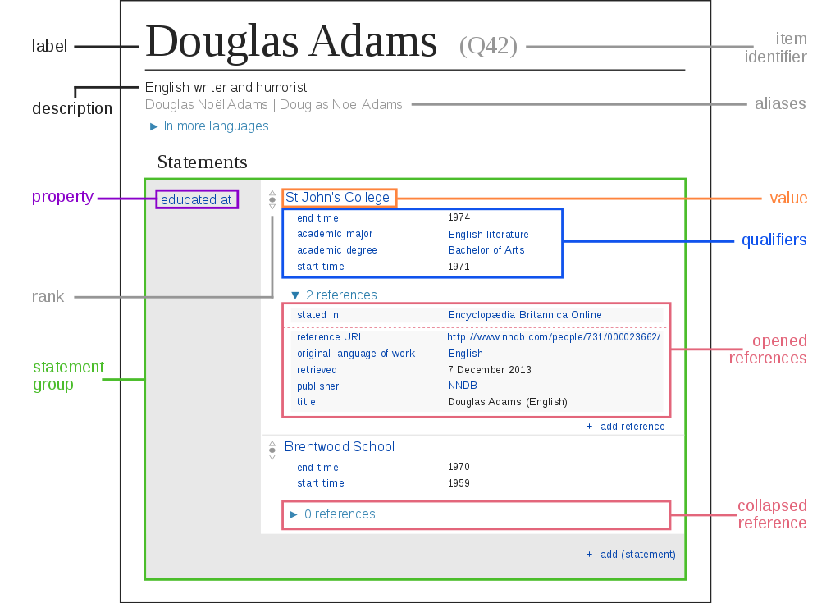
Most well known KGs?
Private:
Google Knowledge Graph
Facebook
E-commerce: Amazon, Zalando,...
Manufacturing: Bosch, Siemens
Public:
Wikidata:
huge open data KG by Wikimedia foundation (document db)
DBPedia:
Structured data in Wikipedia (infoboxes)
Reference DB for KG community
Freebase
=> bought by Google: GKG
Notes:
document = subject page, local star shape in graph (alle information i.e. all edges linked to a node)
dit type documenten hebben we ook in Fabritius
Q42 is een unique identifier, tot op zeker hoogte ook wel persistent denk ik

Slide 27
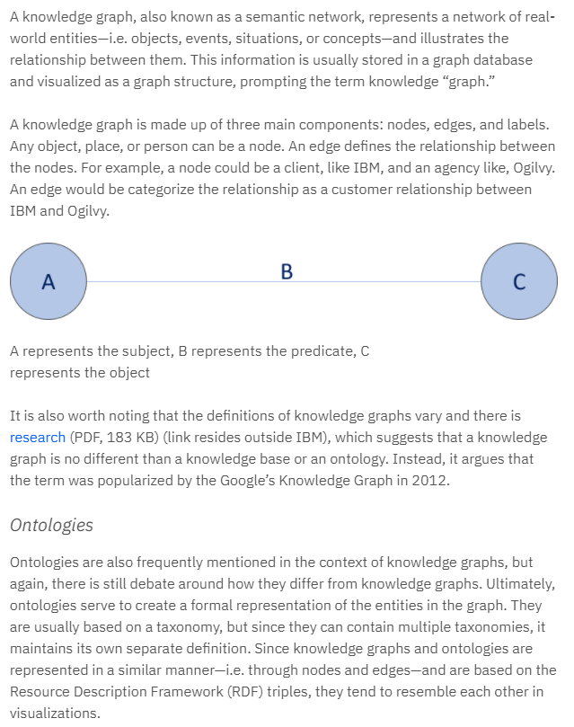
Definition (IBM)
A. Dimou:
“KGs describe entitities and their interrelations using a graph”
KG = {Triples}
A -- (B) --> C
Subject --(Predicate)--> Object
Representation:
RDF standard
Entities ~ represented using URIs
Objects can also be literals
Formal: ~ ontologies ~ describe relationships/vocabularies
ontologies ~ logic/reasoning
Notes:
Google popularized the term knowledge graph

Slide 28
RDF example
Subject: URI
Object: Literal
Predicate ~ foaf (friend-of-a-friend ontology)
@en
language
a
@prefix foaf: <http://xmlns.com/foaf/0.1/>
<.../#me> foaf:name “A. Dimou” .
foaf:Person
class!
Notes:
Bottom RDF dataset (RDF-turtle) don’t forget the dot
Ontology prefixes? https://prefix.cc/

Slide 29
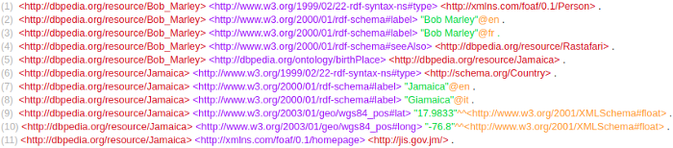
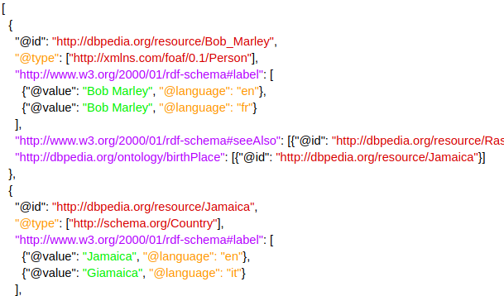
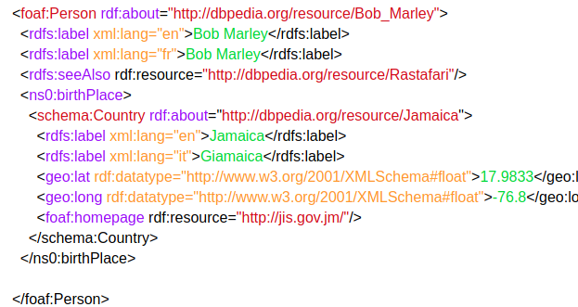
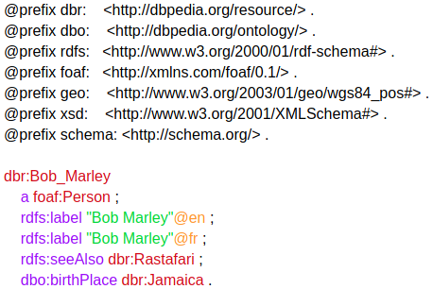
RDF formats
Notes:
https://medium.com/wallscope/understanding-linked-data-formats-rdf-xml-vs-turtle-vs-n-triples-eb931dbe9827
N-triples: most verbose
JSON-LD – RDF/XML
Turtle
Bob Marley is a person => tonen op slide

Slide 30
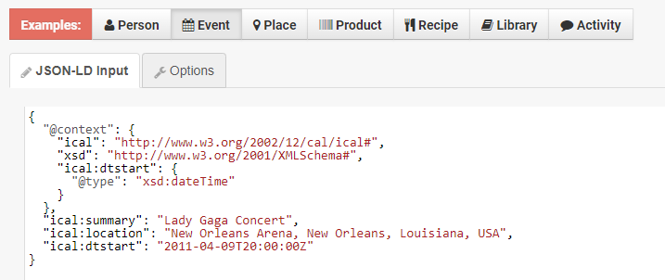
JSON-LD: most relevant here
https://json-ld.org/playground/
prefixes!

Slide 31
YARRRML and Matey
https://rml.io/yarrrml/matey/
Notes:
Check the URI: the YARRRML is quite readable, note YARRRML => YAML data format, also compare to the RML code
Lab!

Slide 32
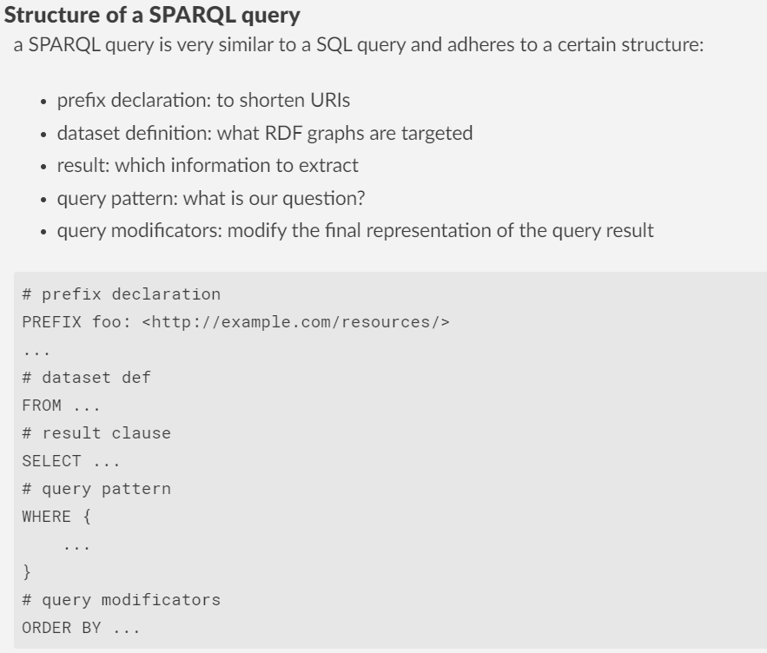
SPARQL a standard for querying KGs

Slide 33





After Generation => KG consumption with SPARQL
SPARQL Protocol and RDF Query Language
Protocol: execute a random query against an REST API
Language ~ SQL but no notion of tables! (graph / service)
Multi-database!
No schema requirements
Basic Graph Patterns
Joins are implicit!
(<URI>,“Carol Chomsky”, 1930-07-01, 2008-12-19)

Slide 34
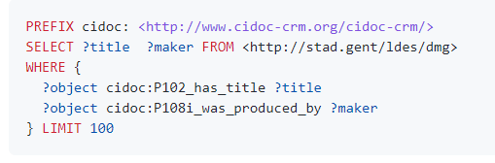
SPARQL demo: Cogent
Query examples workshop 'Collectie vd Gentenaar'
SPARQL containing cidoc-crm
https://github.com/CoGhent/sparql_party/blob/main/README.md

Slide 35
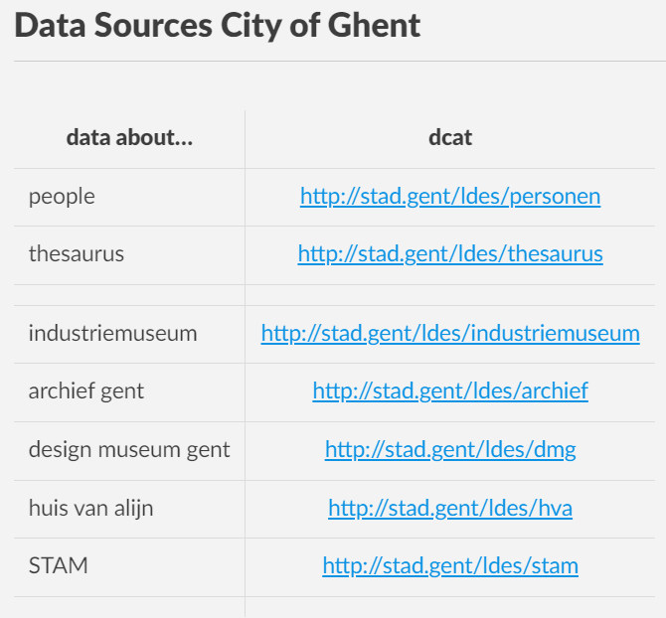
Cogent SPARQL Endpoints
https://github.com/CoGhent/sparql_party => copy pasting

Slide 36

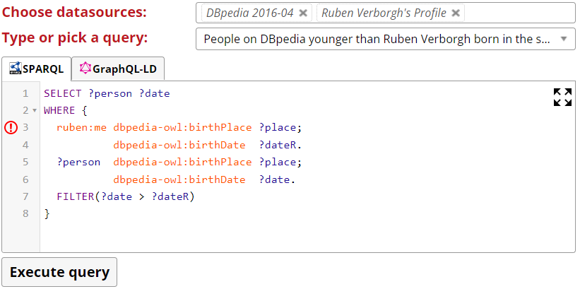
Comunica Web client
Use Comunica to validate queries in the browser
http://query.linkeddatafragments.org/
Exercise: test, modify and try to comprehend the queries in the following tutorial:
https://github.com/CoGhent/sparql_party/blob/main/README.md

Slide 37
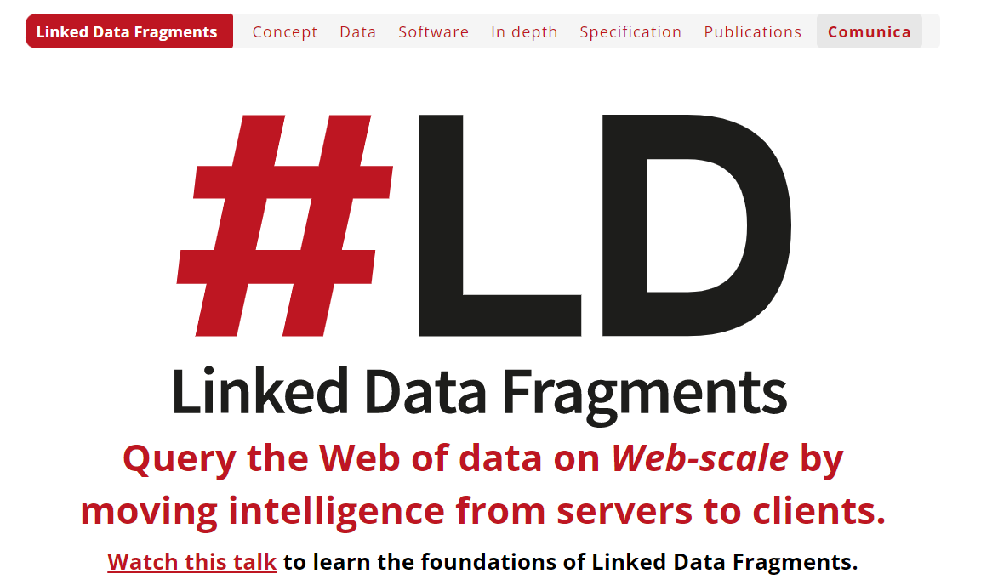
Further reading about LDF clients (LD research)
https://linkeddatafragments.org/

Slide 38
Starters notebook
Dilawar: push to github repo
testing model queries Cogent
2 python SPARQL clients
code samples students
https://github.ugent.be/geeckela/bds_project/blob/master/src/services/coghent-sparql-queries.js
Mary-Beth: https://github.ugent.be/midfranc/BDS_project/blob/main/src/HTTPClient.ts
Stroo: https://github.ugent.be/idpla/BigData-Group-2/blob/main/Code/data_reader.py
De Vijt, SparqlWrapper: https://github.ugent.be/odvijt/Project-BDS/blob/main/DataRetrieval/DataRetrieval.ipynb
Team Solid: https://github.ugent.be/smadcrae/project-bds/blob/master/src/solid/ApiController.ts

Slide 39
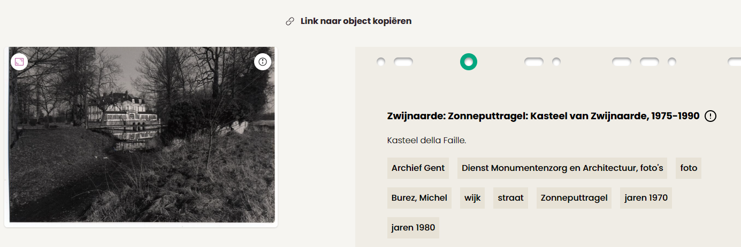
Compare front-end <> API: Kasteel Zwijnaarde
page from collectie.gent, URI has an id:
https://data.collectie.gent/entity/archiefgent:MA_DMA_MB_FO_3579
https://api.collectie.gent/iiif/imageiiif/3/f46364714b6836a3d444df34e4ee0af2-transcode-MA_DMA_MB_FO_3579.jpg/full/%5E1000,/0/default.jpg

Slide 40
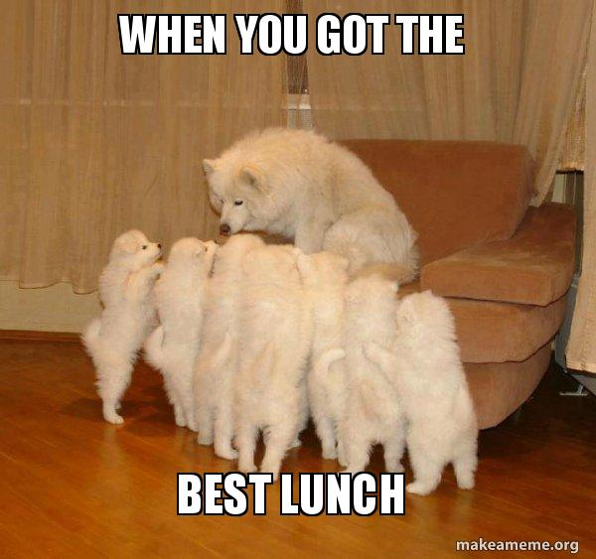
Lunch 12:30 -- 13:30

Slide 41
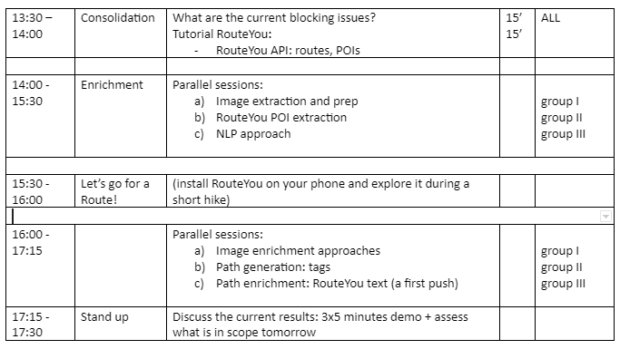
Monday afternoon overview

Slide 42
Tutorial RouteYou: access to data
lessons learnt meeting Pieter V.
python client
Overview of functions / webservices
POI data extraction
LATER: routing // pushing
example queries
starters notebook

Slide 43
Some lessons learnt (23/12/2022)
example: mvisitbrussels.routeyou.com
datastructures: routes & POIs
Cogent: attach descriptions/artworks to POIs & Routes
Routes (A->B, A->A)
Create private sets of POIs ~ work as 'attractors'
Existing route is modified to contain max number of attractors
Custom start/end point routes thematic
Not generative: { POIs } => route is not possible
Stepwise A->B, B->C (+enrichment) is possible
TSP problem => use external doc.graphhopper.com API
Export: booklet!?

Slide 44
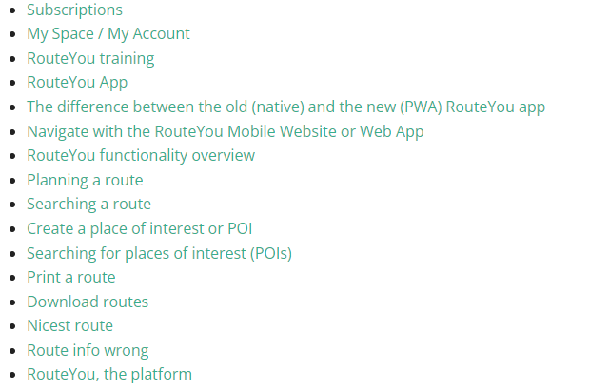
Documentation (help.routeyou.com)
Pieter V.: work in progress!
~Repository for our Cogent's
resulting routes
~30 video's
~all functionality in Enterprise Account
~RY thematic route generation
~RY Knowledge Graph to enrich
our thematic routes!
~RY 'niceness' heuristic

Slide 45
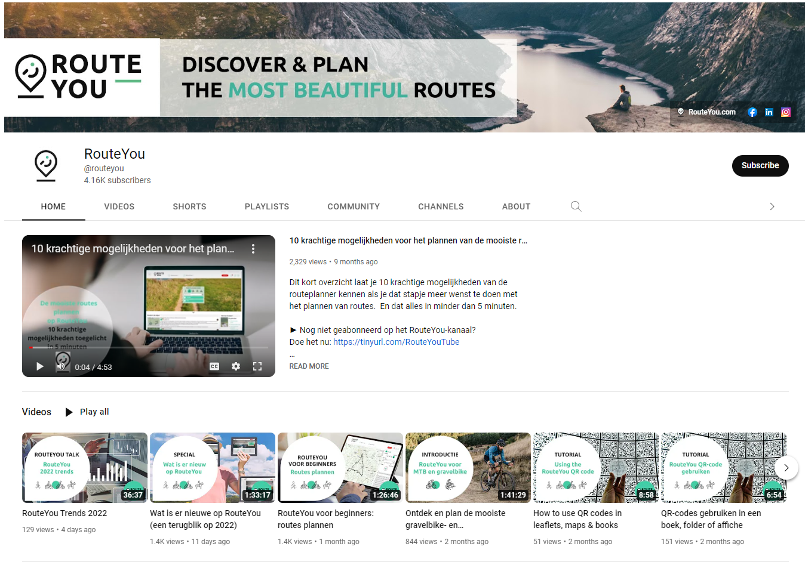

Slide 46
RouteYou Webservices
XML-RPC (depr.), JSON-RPC, JSONP => Python client
Services:
OAuth 2.0: authenticate to our APIs, request access to a user's data
User 2.0: log in to access personal data, get information about users.
Session 2.0: start a session, get information about your session.
Group 2.0: search and get information about groups.
Route 2.0: search and get information about routes.
Poi 2.0: search and get information about places of interest.
Routing 2.0: calculate the route between points.
Job 2.0: get information about queue jobs.
security key!
https://help.routeyou.com/en/topic/view/114/web-services

Slide 47
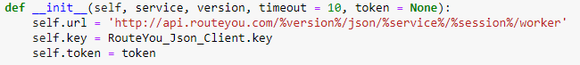
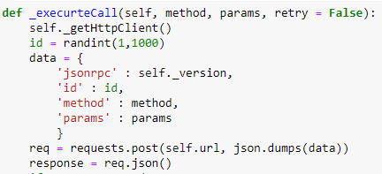
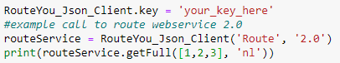
Overview of python library
Library is just wrapper that generates RPC call
Convert to POST
Create call:

Slide 48
TODO Dieter: POI extraction

Slide 49
TODO Dieter: play with routes

Slide 50
TODO Dieter: push data
check account information (webmail)

Slide 51


